Slide 1
4.3: Trigonometric Functions of Angles
MATH 1550 - Precalculus

Slide 2
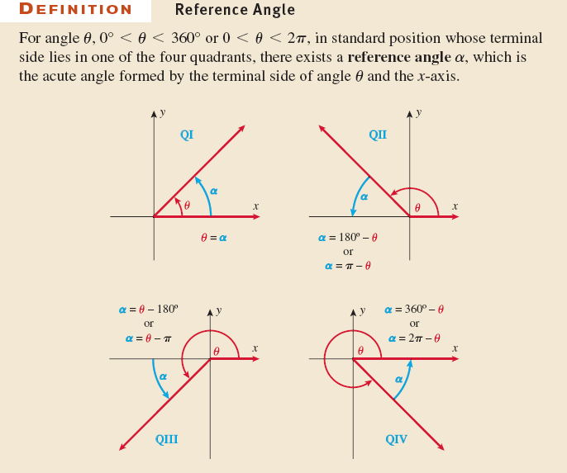

Reference Angles
If your angle’s terminal side lands in one of the four quadrants, you can make an acute angle with the $x$-axis called the reference angle.

Slide 3


Reference Right Triangles
Reference angles are formed by extending a vertical line from the terminal side to the x-axis.
This forms a right triangle.
Useful for evaluating angle all angle measurements!
$${135}^{∘}$$
$${45}^{∘}$$

Slide 4
Algebraic Signs of Trigonometric Functions
Sign of output of trigonometric function depends on the quadrant the terminal side lands in.
ASTC: All Students Take Calculus, or Add Sugar To Coffee
S
A
T
C

Slide 5

Example
If the terminal side an angle $θ$ in standard position passes through $(3, 4)$, find the values of the six trigonometric functions for angle $θ$.

Slide 6

Example
If the terminal side an angle $θ$ in standard position passes through $(−3, −5)$, find the values of the six trigonometric functions for angle $θ$.

Slide 7

Ex: If $sin⁡θ = −\frac{3}{4}$ and the terminal side of $θ$ lies in QIII, find $cos⁡θ$.

Slide 8

Ex: Determine if the following equations are possible. Explain why.
$sin⁡θ = 2$.
$tan⁡θ = 2$.
$cos⁡θ = 0.5$.

